Slide 1
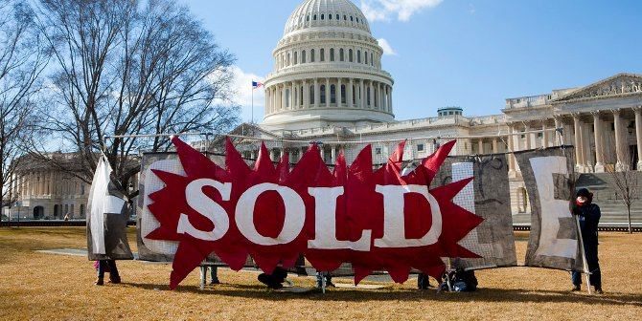

Follow the Money
Kate Field, J.A. Gorman, Richard Moseley, Angelique Tucker and Lauren Van Wagoner

Slide 2
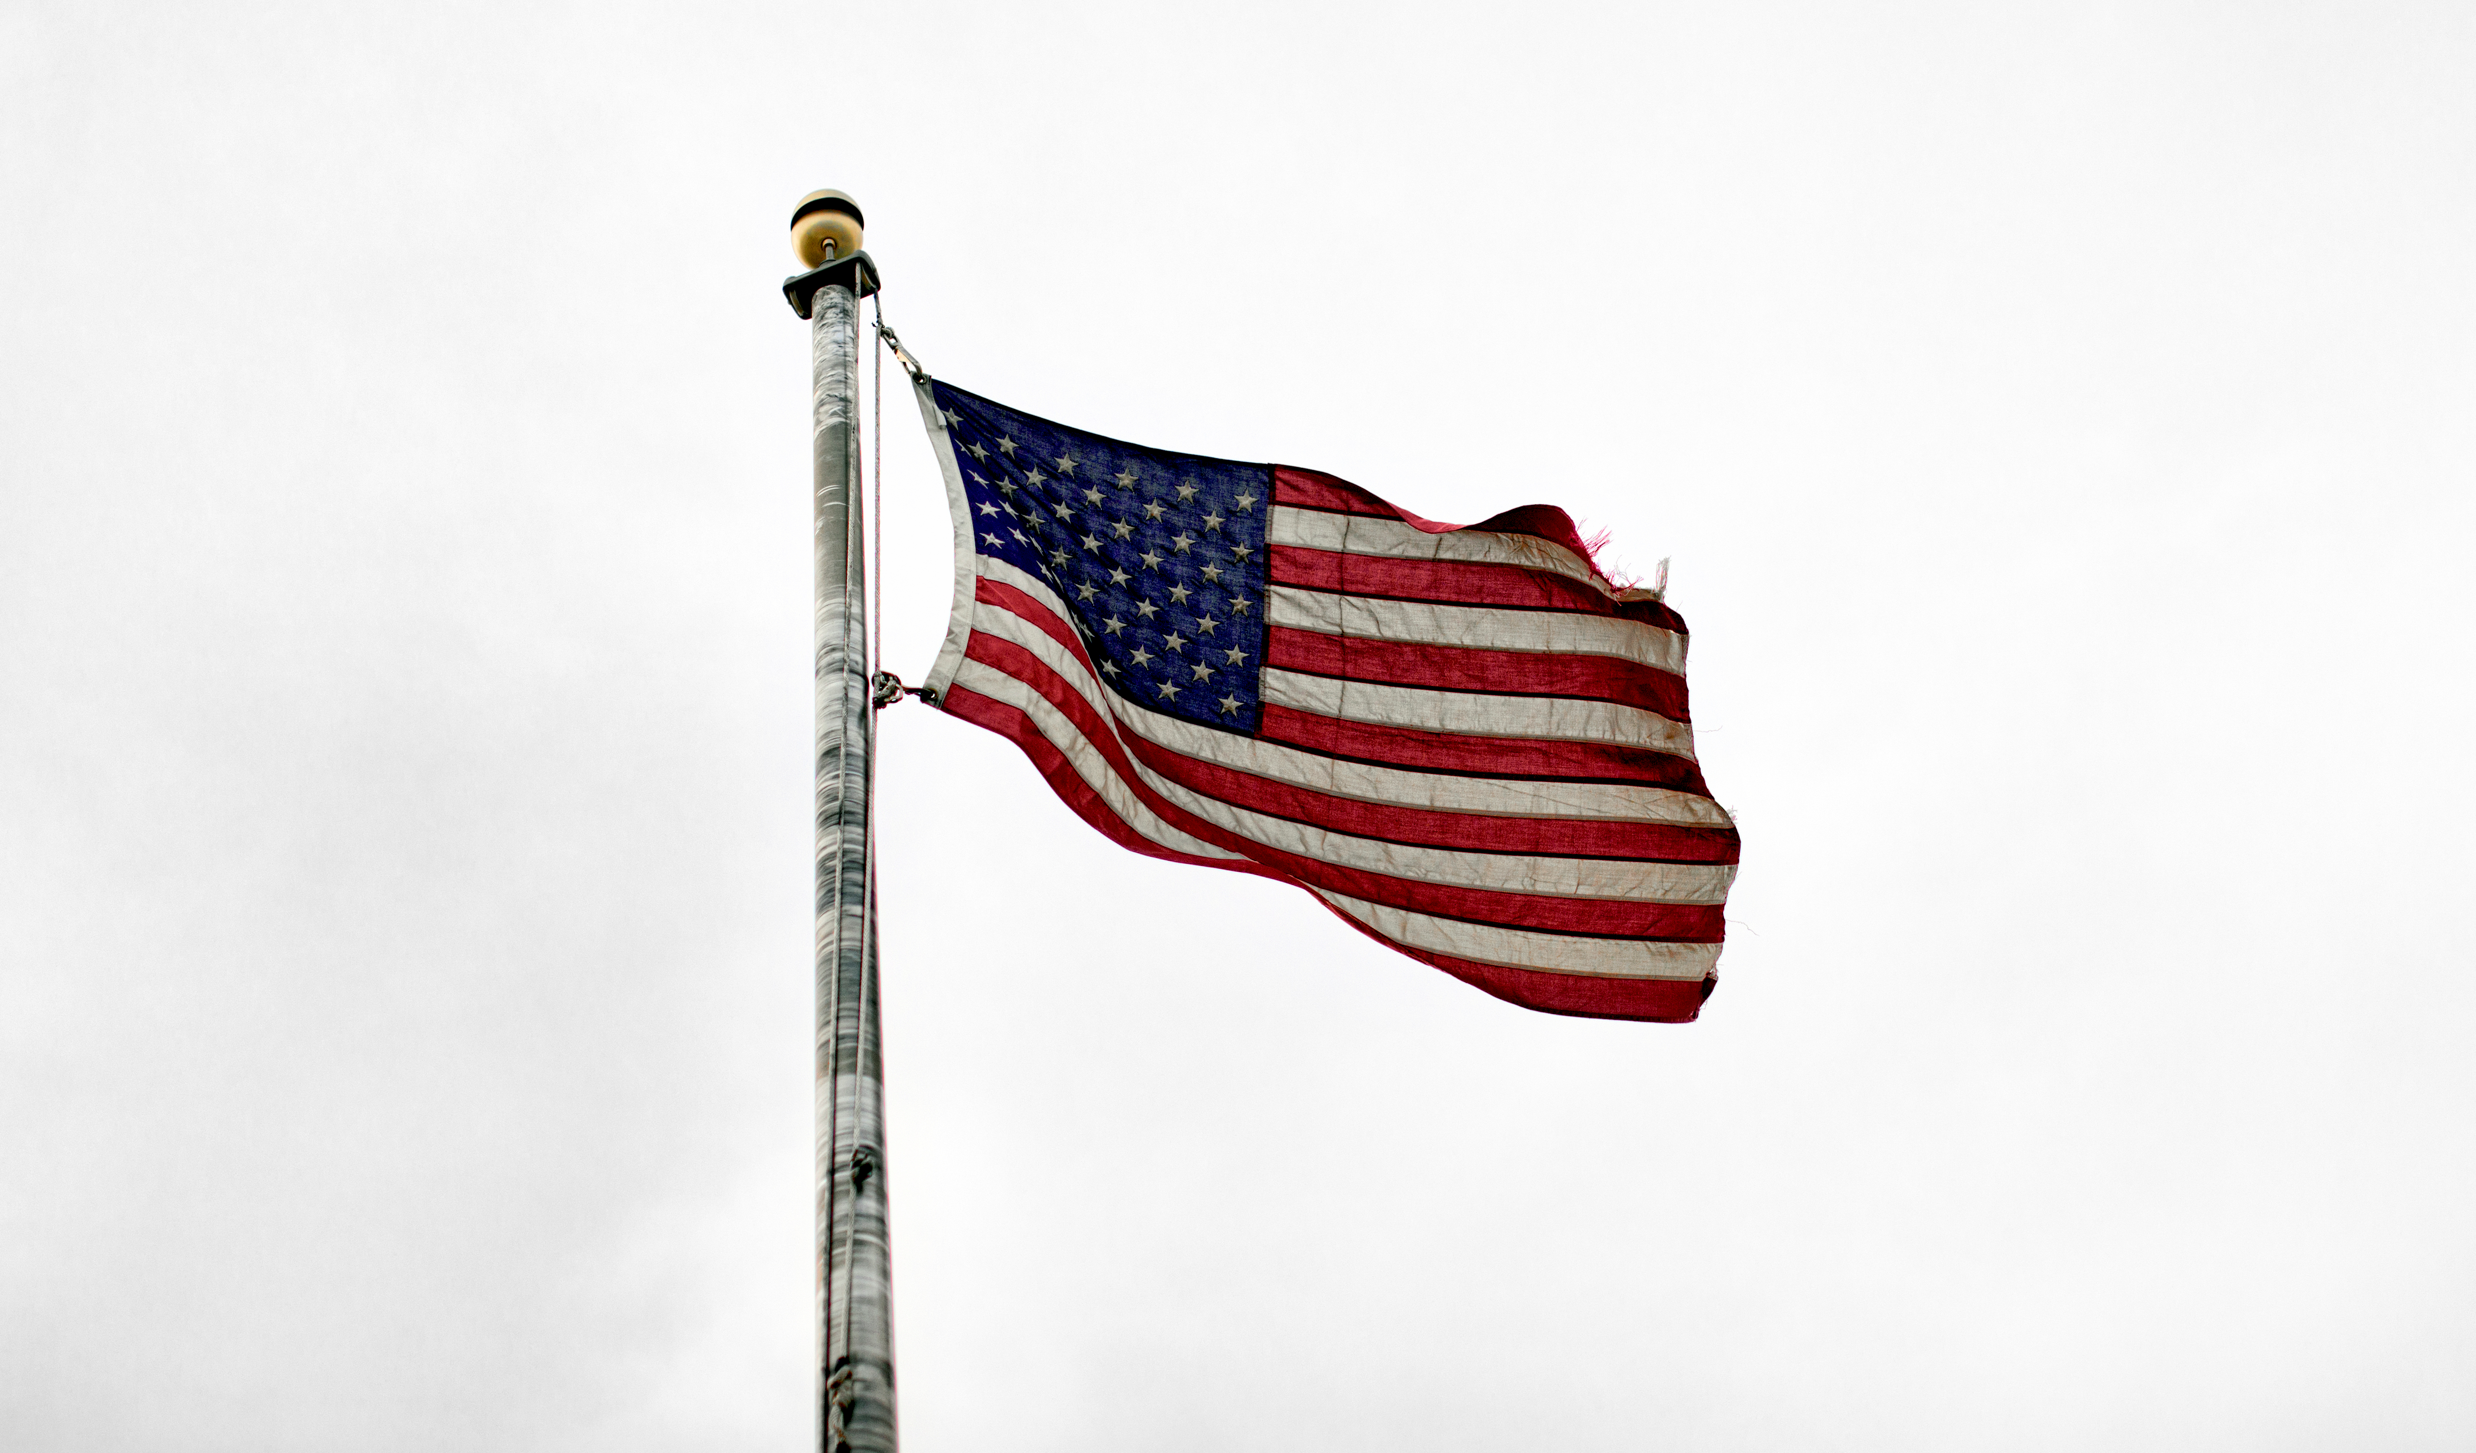
Overview
Kansas
Senate:
Jerry Moran
Roger Marshall
House Representatives:
Steve Watkins
Pat Roberts
Sharice Davids
Ron Estes
We will be breaking down congressional districts in Kansas and Missouri as of 2020 and whether or not the top donors correlate with the candidate platform for Senate and House Representatives for the states of Missouri - Senate: 2 House: 8 and Kansas- Senate: 2 House: 4. Our machine learning will predict the donors who they give their money to by party.
Missouri
Senate:
Josh Hawley
Roy Blunt
House Representatives:
Cori Bush
Ann Wagner
Blaine Luetkemeyer
Vicky Hartzler
Emmanuel Cleaver
Samuel Graves
William(Billy) Long
Jason Smith

Slide 3

Researched alternate sources for geomapping data to establish through google
Longitude and latitude of Districts House and Senate
Longitude and Latitude of Donors or Map by address
Our Group Intended to have a Map for Kansas and Missouri with the current House and Senate Representatives with their total donations by election year and the names of their Top 10 Primary Contributors.
Data Obtained
Legislators Names and Represented State as of January 2020
Total amount of Funds Donated and Campaign Funds
Candidate Party
Data Not Obtained or Incomplete
If the candidate was voted out or retired the new Candidate had not been updated in the API data
There is not geographical data for the Candidates or the Contributors to add data to the Map and layer.
The data obtained is extensive and in multiple files to be tied together.

Slide 4
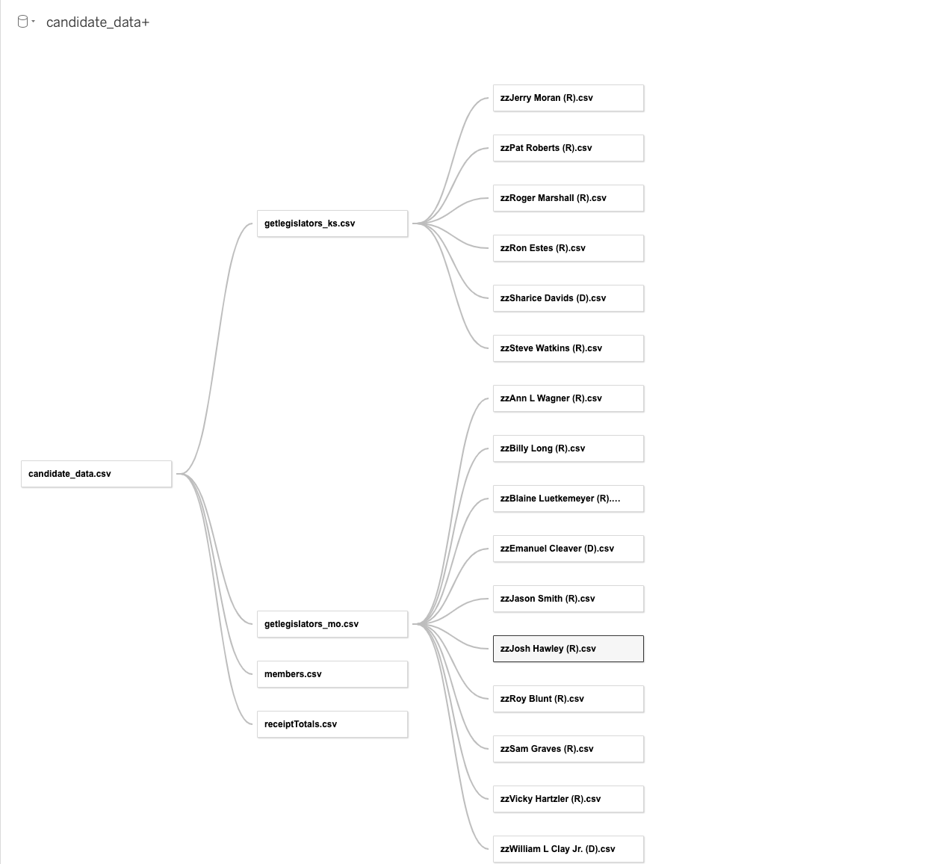
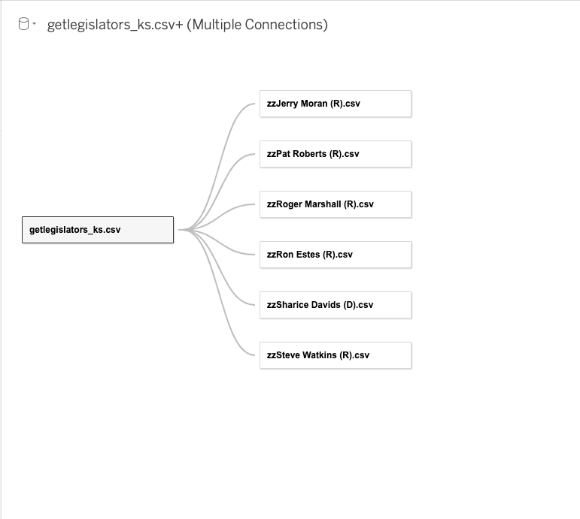
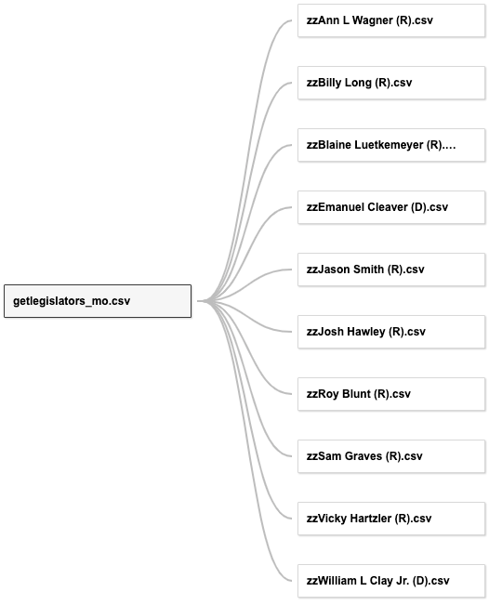
Combined Kansas Missouri

Slide 5
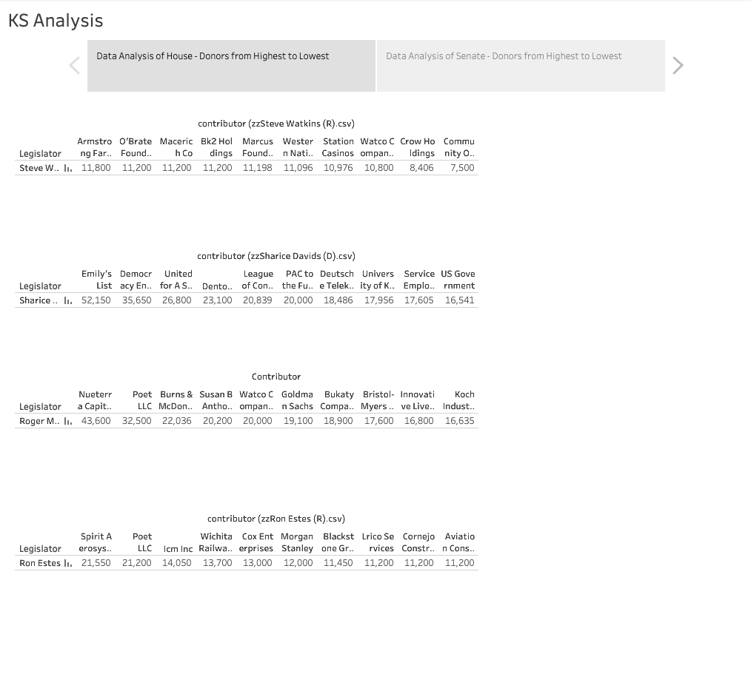
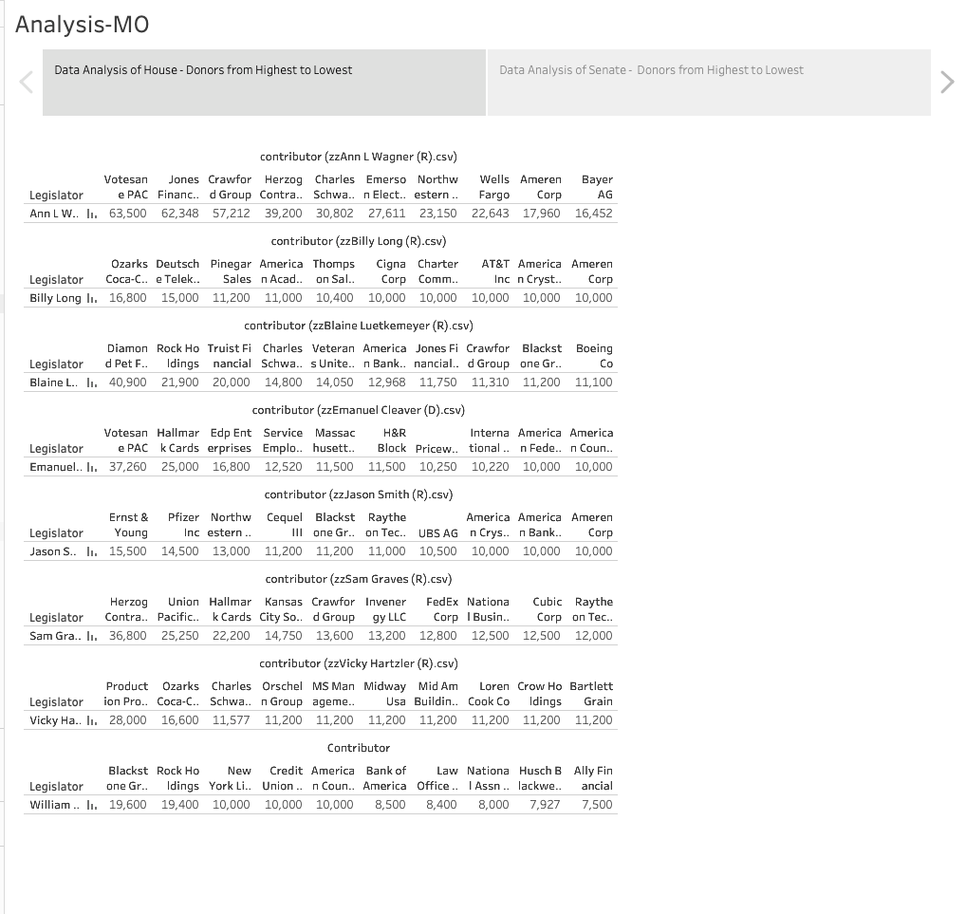

Slide 6

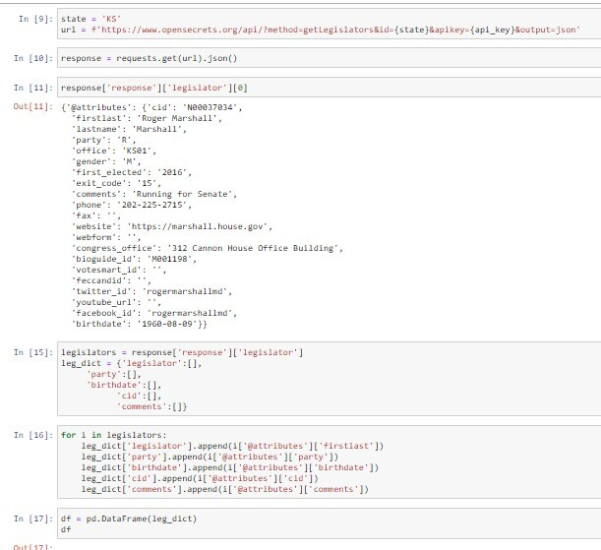
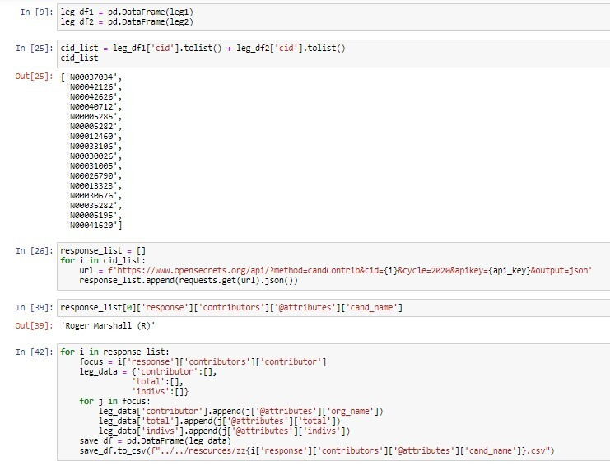
This Photo by Unknown Author is licensed under CC BY-SA

Slide 7
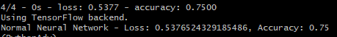
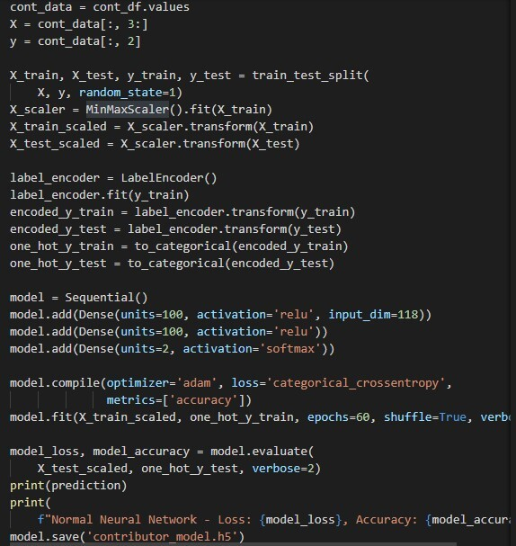
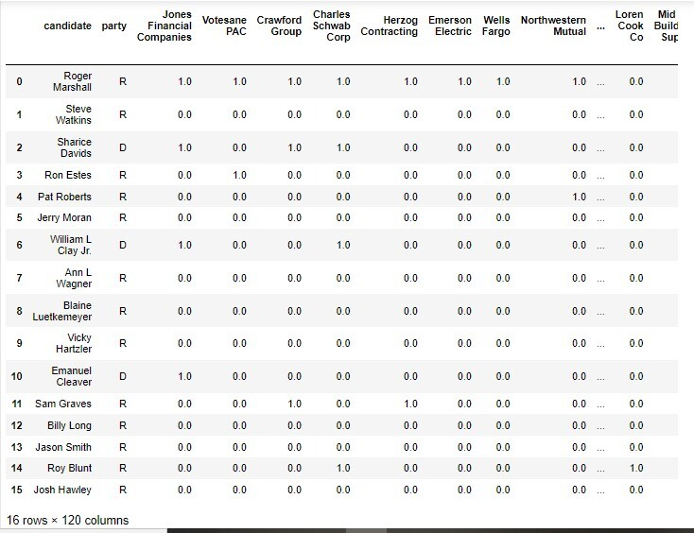
Machine Learning
Model in Python
ML Stats
Preprocessed Data

Slide 8
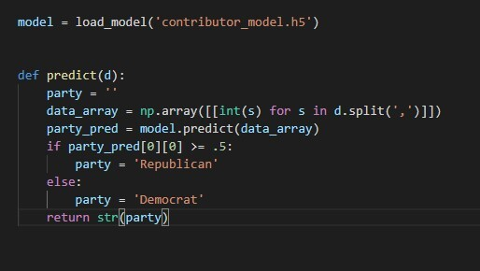
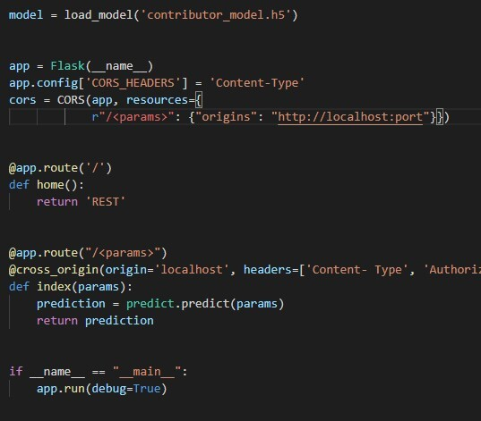
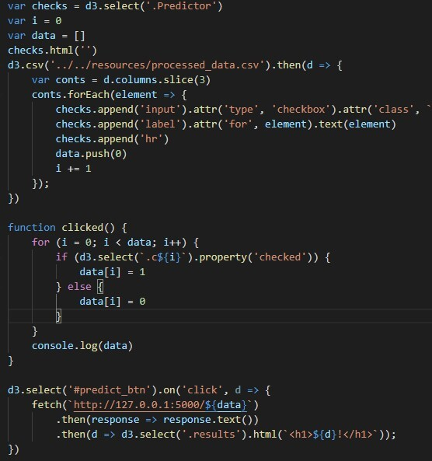
Machine Learning
Server to transfer predicted data between Javascript and Python
Predicting Function in Python
Checking boxes to make prediction in Javascript

Slide 9
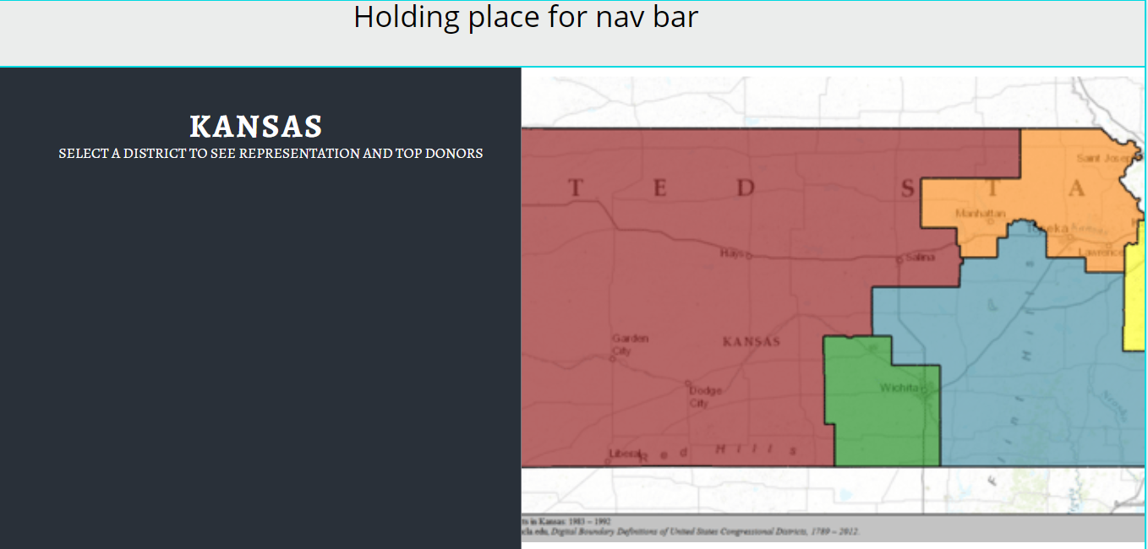
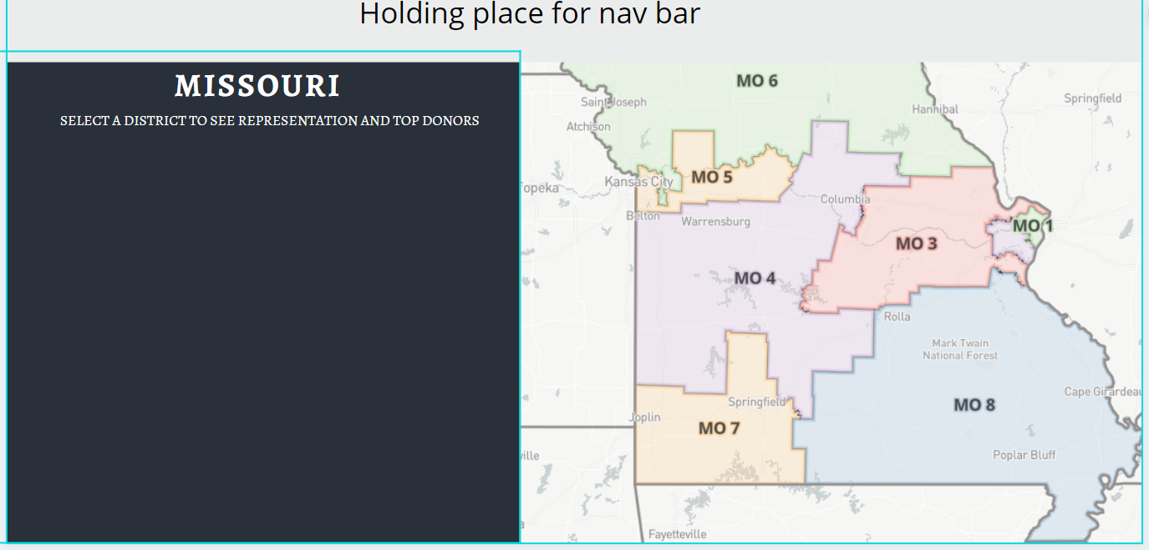
Design Ideas for Kansas and Missouri

Slide 10
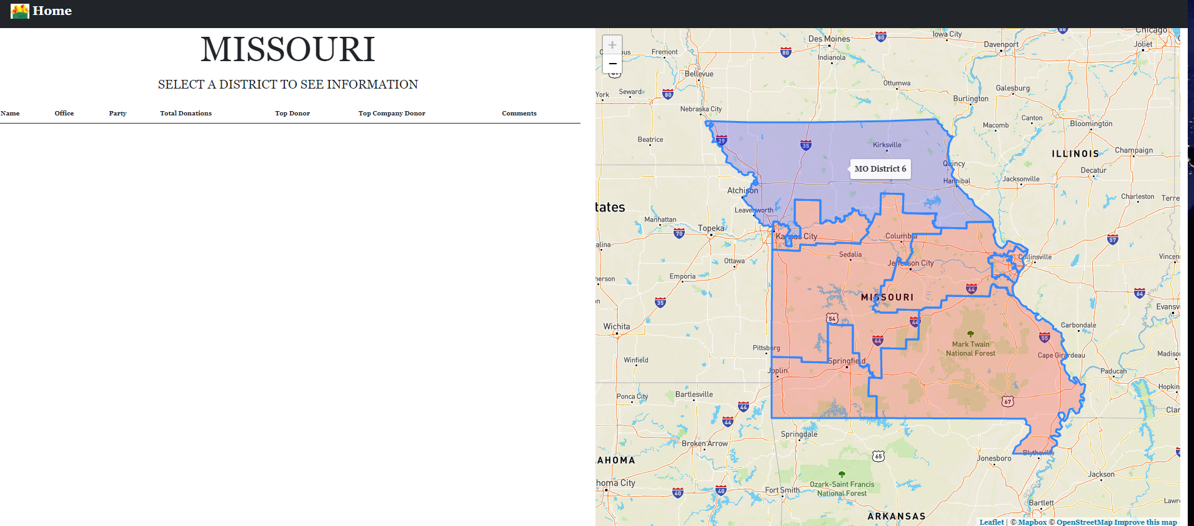
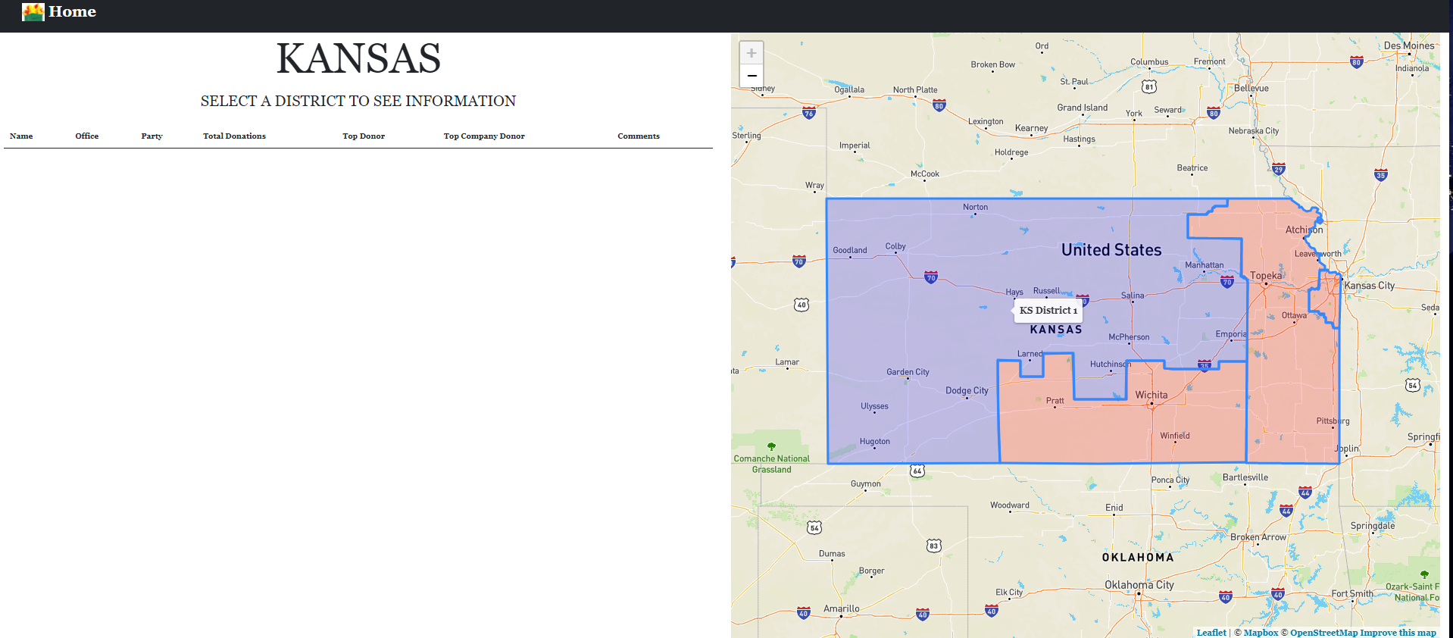
Progress for HTML Kansas and Missouri

Slide 11
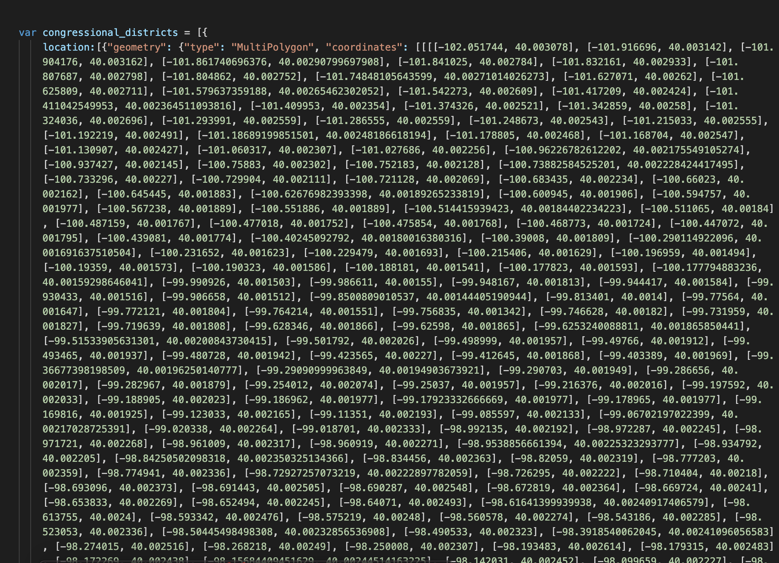
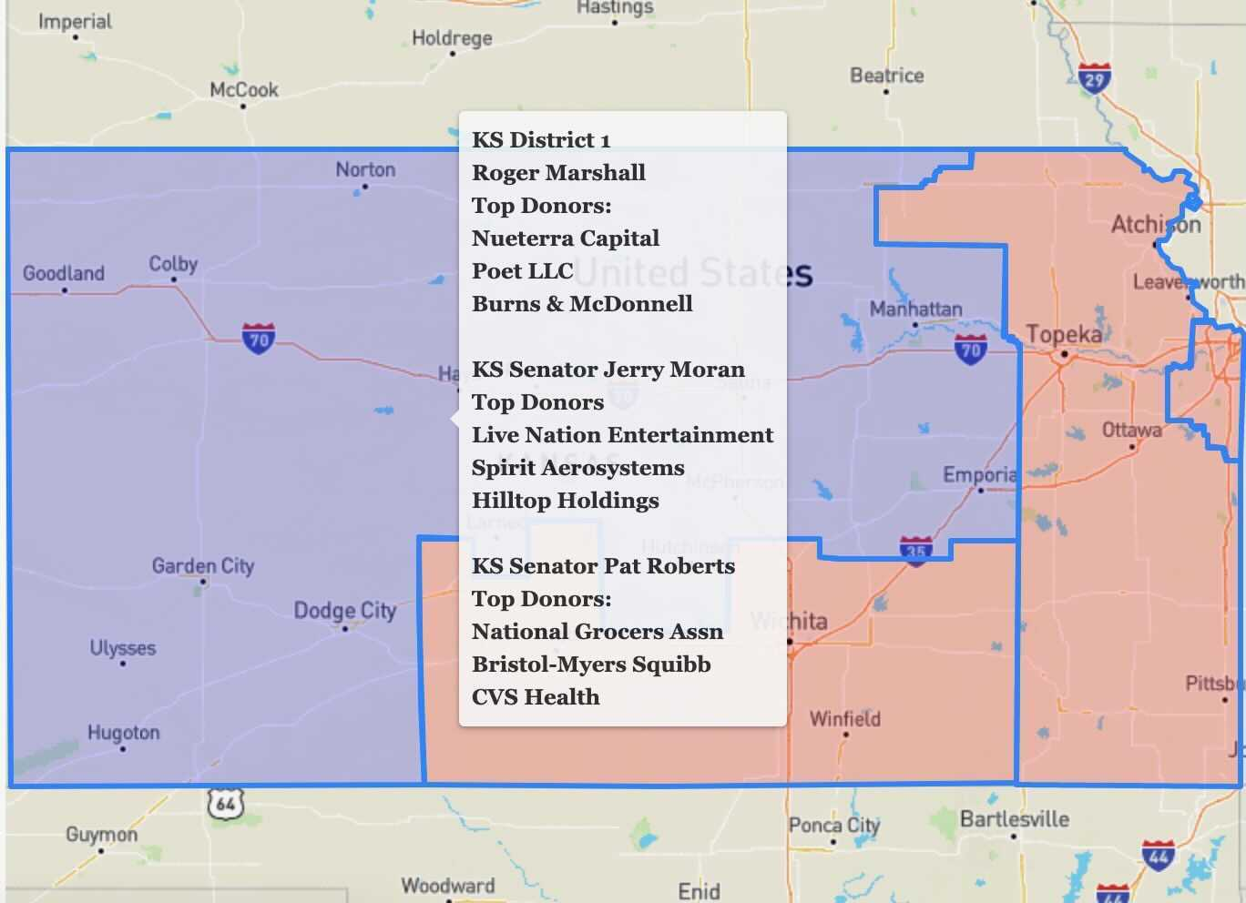
HTML Map Design

Slide 12
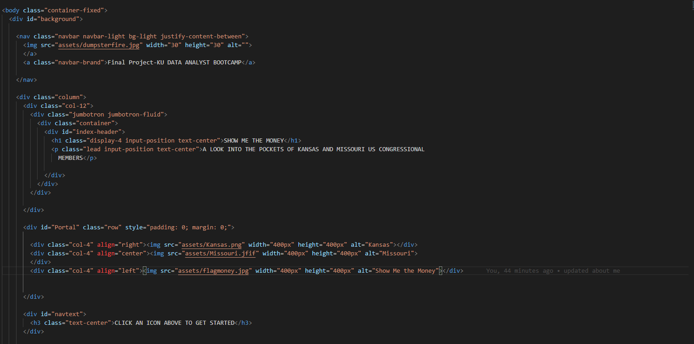
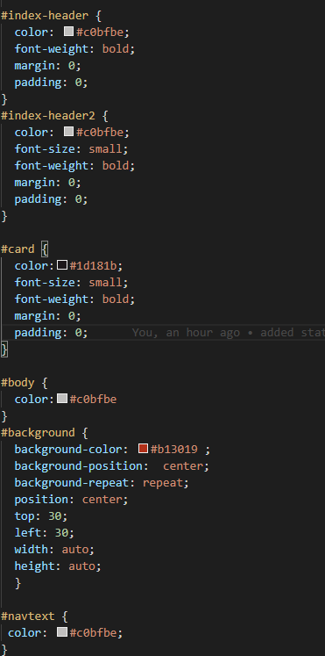

HTML Design

Slide 13
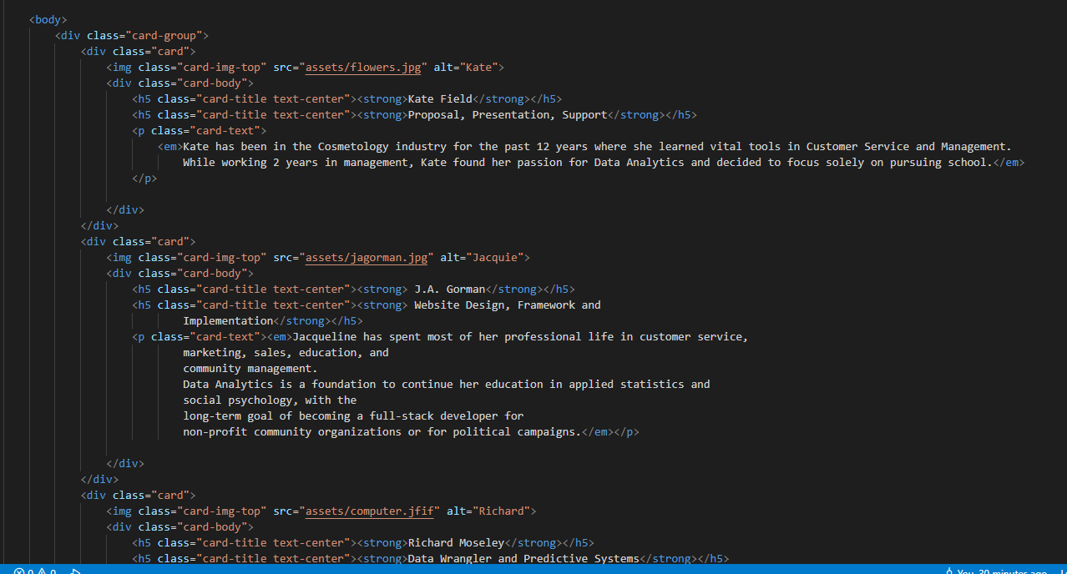
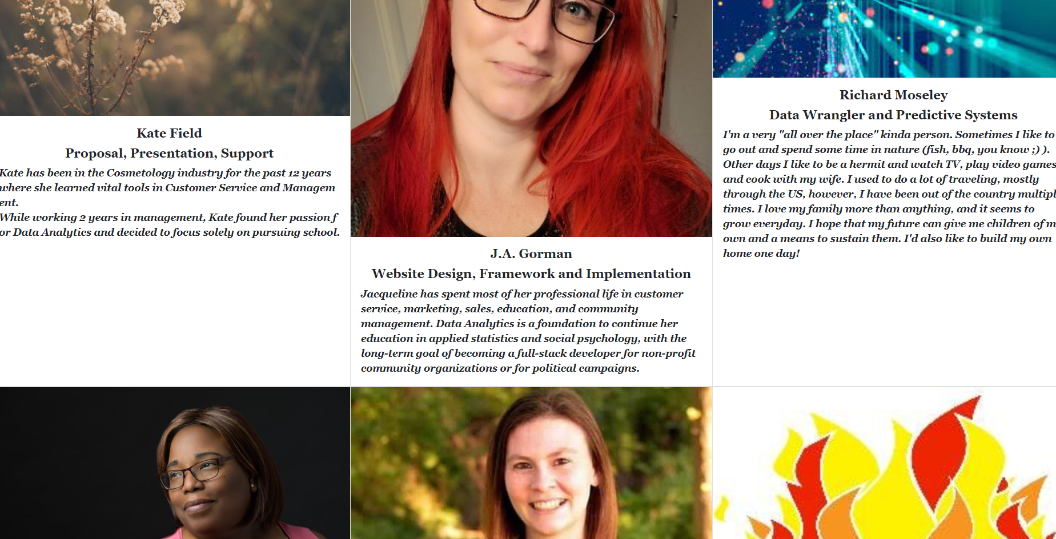
HTML Design

Slide 14
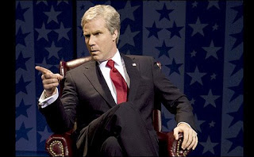
Git Hub Repository
https://jagorman.github.io/Follow-the-Money-2.0/index.html

